Slide 1
C++
Operator precedence

Slide 2
What is operator precedence?
e = a + b * c / d;
Given the above, what should the compiler do?

Slide 3
Operator precedence
Can be complicated
Higher precedence operators will be evaluated first

Slide 4
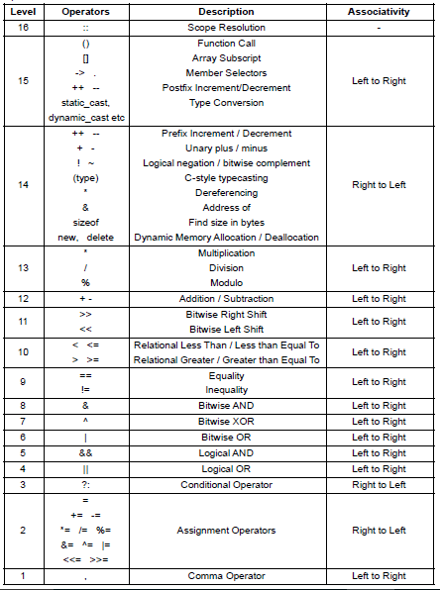

Slide 6
Precedence
a * b + c
Multiply has higher precedence than +
compiler -> ( a * b ) + c
Brackets have higher precedence, so this
a * (b + c)
would work as expected

Slide 7
PEMDAS
Parentheses (Brackets – BEMDAS?)
Exponents
Multiplication and Division (left to right)
Addition and Subtraction (left to right)

Slide 8
int a = 20; int b = 10; int c = 15; int d = 5; int e;
e = (a + b) * c / d; e = ((a + b) * c) / d; e = (a + b) * (c / d); e = a + (b * c) / d;

Slide 9
Comma operator
a = (b=3, b+2)

Slide 10
Comma operator
a = (b=3, b+2)
3 assigned to b
a is assigned to b+2 … 5

Slide 11
Tricky bits
Operators that have the same precedence are bound to their arguments in the direction of their associativity
a = b = c
= is right-to-left associative
a = (b = c)

Slide 12
Tricky bits
+ and – are left-to-right associative
a + b - c
is
(a + b) - c

Slide 13
Example
int a = 10;
int b = 5;
char d = 'x’;
cout << a - b * sizeof d << endl;
sizeof char is 1

Slide 14
More questions
y = 3 + 4 + 5;
z = 2;
z *= ++y + 5;
x = 2 + 3 % 4
a || b && c || d

Slide 15
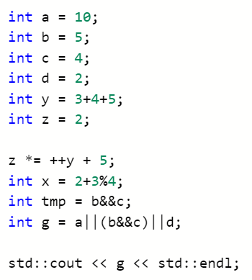
More questions

Slide 16
More questions
Boolean &&
Boolean ||
https://repl.it/@JohnGlazebrook/c-operator-precedence

Slide 17
This is not in the exam
The following slide demonstrates how the compiler works, you don’t need to know this for the exam
Just because it’s interesting

Slide 18
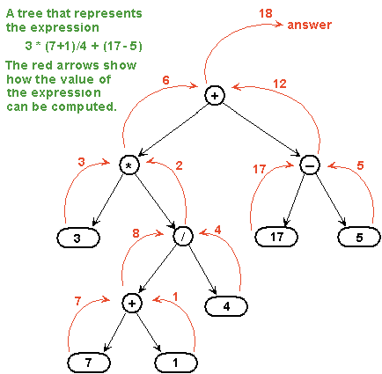
An interesting aside:

Slide 19
The c++ spec
https://en.cppreference.com/w/cpp/language/operator_precedence
Make sure you know it
Make sure you come back to it
Make sure you reference it when answering the questions

Slide 20
Write some little programs
Demonstrate operator precedence
Create a little power point – 3 or 4 puzzles and answers
Puzzle 1, answer 1, puzzle 2, answer 2, etc…
We will test each other next lesson
Investigate for loops
Using for loops display the two times table up to 12 x 2

Slide 21
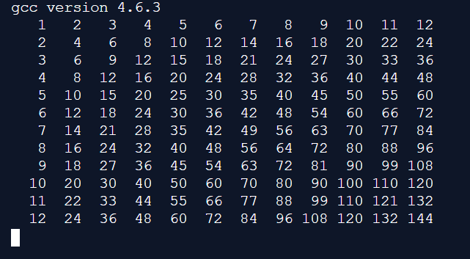
printf()
Or “\t” ?

